Slide 1


Forward Pass

Slide 2



Forward Pass
x = -2
$$f\left(x,y,z\right)=\left(x+y\right)z$$
q = 3
$$q=x+y$$
$$f=q×y$$
y = 5
f = -12
z = -4

Slide 3
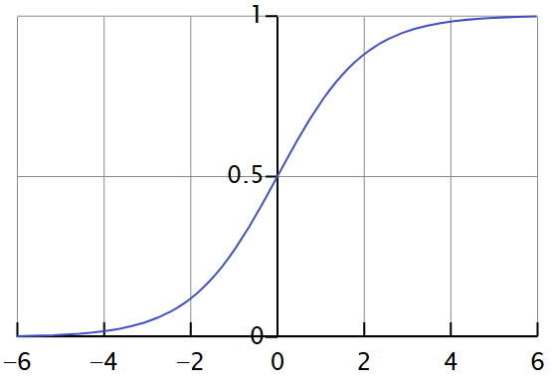

Activation Function
X₁^{[1]}
W₁ ^{[1]}
W₁^{[1]} X₁^{[1]} + W₂^{[1]}X₂^{[1]} + W₃^{[1]} X₃^{[1]} + B₁^{[1]}
W₂ ^{[1]}
$$\hat{y}$$
Z₁ ^{[1]} =
a ^{[1]} = g(Z^{[1]})
X₂^{[1]}
X₃^{[1]}
W₃ ^{[1]}
B₁^{[1]}
1 Hidden Unit
Output
Input

Slide 4

Forward Pass
X₁^{[1]}
W₁ ^{[1]}
W ^{[2]}
W₁^{[1]} X₁^{[1]} + W₂^{[1]}X₂^{[1]} + W₃^{[1]} X₃^{[1]} + B₁^{[1]}
W₂ ^{[1]}
Z₁ ^{[1]} =
a ^{[1]} = g(Z^{[1]})
$$\hat{y}$$
X₂^{[1]}
Z₁ ^{[2]} =
W ^{[2]} a ^{[1]}
a ^{[2]} = g(Z^{[2]})
X₃^{[1]}
W₃ ^{[1]}
B₁^{[1]}
Input
2 Hidden Unit
Output

Slide 5
Deep Network
W₁ ^{[1]}
W₁ ^{[2]}
X₁^{[1]}
W₁ ^{[3]}
W₂ ^{[1]}
$$\hat{y}$$
X₂^{[1]}
Compute Loss/ Cost Function
W₃ ^{[1]}
W₂ ^{[2]}
X₃^{[1]}
B₁^{[1]}
B₁^{[2]}
Input
Hidden
Output

Slide 6
Loss Vs Cost Function

Slide 7
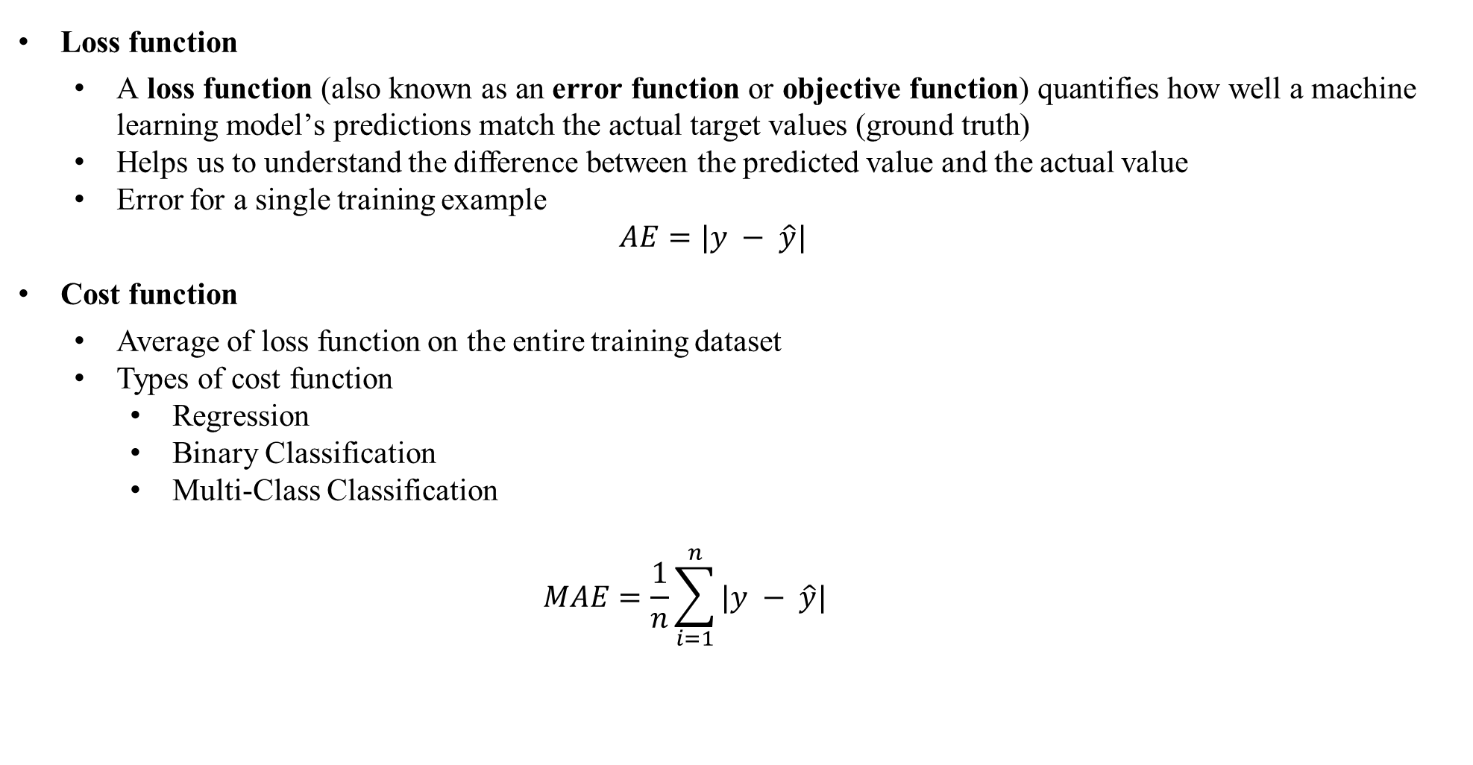
Loss Vs Cost Function
Loss function
$\text{A} \text{loss} \text{function}\text{ (}\text{also} \text{known} \text{as} \text{an} \text{error} \text{function} \text{or} \text{objective} \text{function}\text{) }\text{quantifies} \text{how} \text{well} \text{a} \text{machine} \text{learning} \text{model}\text{’}\text{s} \text{predictions} \text{match} \text{the} \text{actual} \text{target} \text{values}\text{ (}\text{ground} \text{truth}\text{)}$
Helps us to understand the difference between the predicted value and the actual value
Error for a single training example
$$AE=|y − \hat{y}|$$
Cost function
Average of loss function on the entire training dataset
Types of cost function
Regression
Binary Classification
Multi-Class Classification
$$MAE=\frac{1}{n}\sum_{i=1}^{n}{|y − \hat{y}|}$$

Slide 8
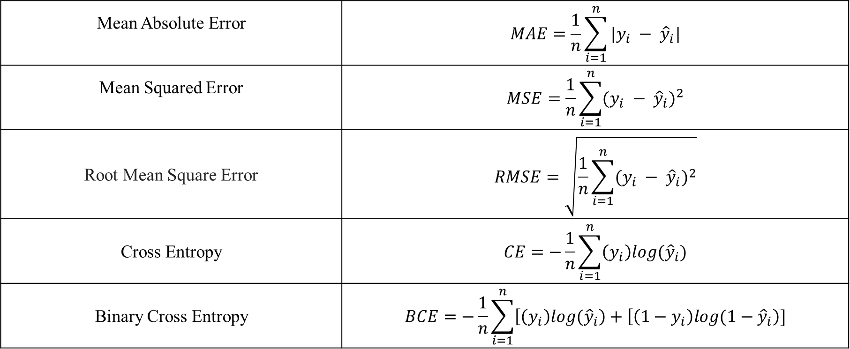
Cost Function
Mean Absolute Error | $$MAE=\frac{1}{n}\sum_{i=1}^{n}{|y_{i} − {\hat{y}}_{i}|}$$
Mean Squared Error | $$MSE=\frac{1}{n}\sum_{i=1}^{n}{{(y_{i} − {\hat{y}}_{i})}^{2}}$$
Root Mean Square Error | $$RMSE=\sqrt{\frac{1}{n}\sum_{i=1}^{n}{{(y_{i} − {\hat{y}}_{i})}^{2}}}$$
Cross Entropy | $$CE=−\frac{1}{n}\sum_{i=1}^{n}{\left(y_{i}\right)log{(\hat{y}}_{i})}$$
Binary Cross Entropy | $$BCE=−\frac{1}{n}\sum_{i=1}^{n}{\left[\left(y_{i}\right)log{(\hat{y}}_{i}\right)+\left[\left(1−y_{i}\right)log{(1−\hat{y}}_{i}\right)]}$$

Slide 9
Cost Function Regression
Cost Functions | Type | Pros | Cons
Mean Absolute Error (MAE) | Regression | Robust to outliers Intuitive interpretation Represents the average absolute error | Not differentiable at zero. Ignores error direction (positive or negative).
Mean Squared Error (MSE) | Regression | Differentiable and widely used Penalizes large errors more than small errors | Sensitive to outliers Units are squared
Root Mean Squared Error (RMSE) | Regression | Same unit as the target variable Penalizes large errors but not excessively. | Sensitive to outliers Less robust for skewed distributions

Slide 10
Cost Function
Cost Functions | Type | Pros | Cons
Cross-Entropy | Classification | Suitable for multi-class classification. Clear probabilistic interpretation. | Requires calibrated probabilities to work effectively
Binary Cross-Entropy | Classification | Suitable for binary classification tasks Encourages well-calibrated probabilities | Can suffer from vanishing gradients Not ideal for multi-class problems
Softmax Cross-Entropy | Classification | Appropriate for multi-class classification Encourages class separation | Requires one-hot encoded labels Sensitive to outliers. May not work well with imbalanced data.

Slide 11

Gradient Descent

Slide 12
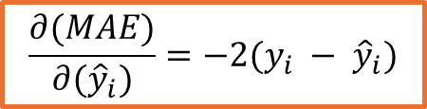
Deep Network
W₁ ^{[1]}
W₁ ^{[2]}
X₁^{[1]}
$$\frac{∂(MAE)}{∂({\hat{y}}_{i})}=−2(y_{i} − {\hat{y}}_{i})$$
W₁ ^{[3]}
W₂ ^{[1]}
$$\hat{y}$$
X₂^{[1]}
Compute Loss/ Cost Function
W₃ ^{[1]}
W₂ ^{[2]}
X₃^{[1]}
B₁^{[1]}
B₁^{[2]}
Input
Hidden
Output

Slide 13
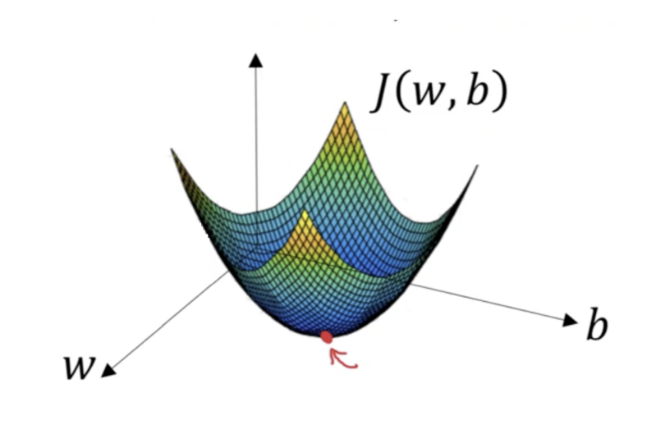
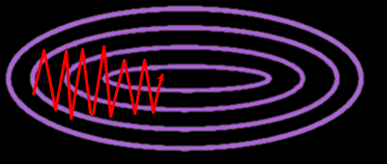
Gradient Descent
It is an optimization algorithm
Minimizes a given function to its local minima
It is a measure of change in weights with respect to change in error (Slope function)
If slope/gradient is zero then model stops learning

Slide 14
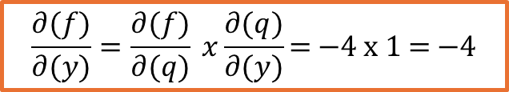

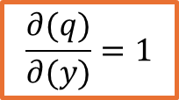
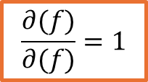
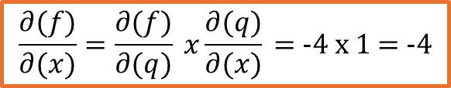
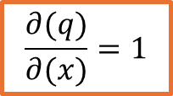
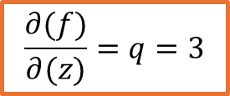

Gradient
x = -2
$$f\left(x,y,z\right)=\left(x+y\right)z$$
q = 3
$$q=x+y$$
y = 5
f = -12
$$f=q×y$$
Gradient from Previous Layer
Local Gradient
z = -4
$$Chain Rule$$
$$\frac{∂(q)}{∂(x)}=1$$
$$\frac{∂(f)}{∂(x)}=\frac{∂(f)}{∂(q)} x\frac{∂(q)}{∂(x)} \text{= −4 }\text{x}\text{ 1 = −4}$$
$$\frac{∂(f)}{∂(f)}=1$$
$$\frac{∂(q)}{∂(y)}=1$$
$$\frac{∂(f)}{∂(y)}=\frac{∂(f)}{∂(q)} x\frac{∂(q)}{∂(y)}\text{= }\text{−4} \text{x}\text{ 1 = −4}$$
$\frac{∂(f)}{∂(q)}=z$ = -4
$$\frac{∂(f)}{∂(z)}=q=3$$

Slide 15
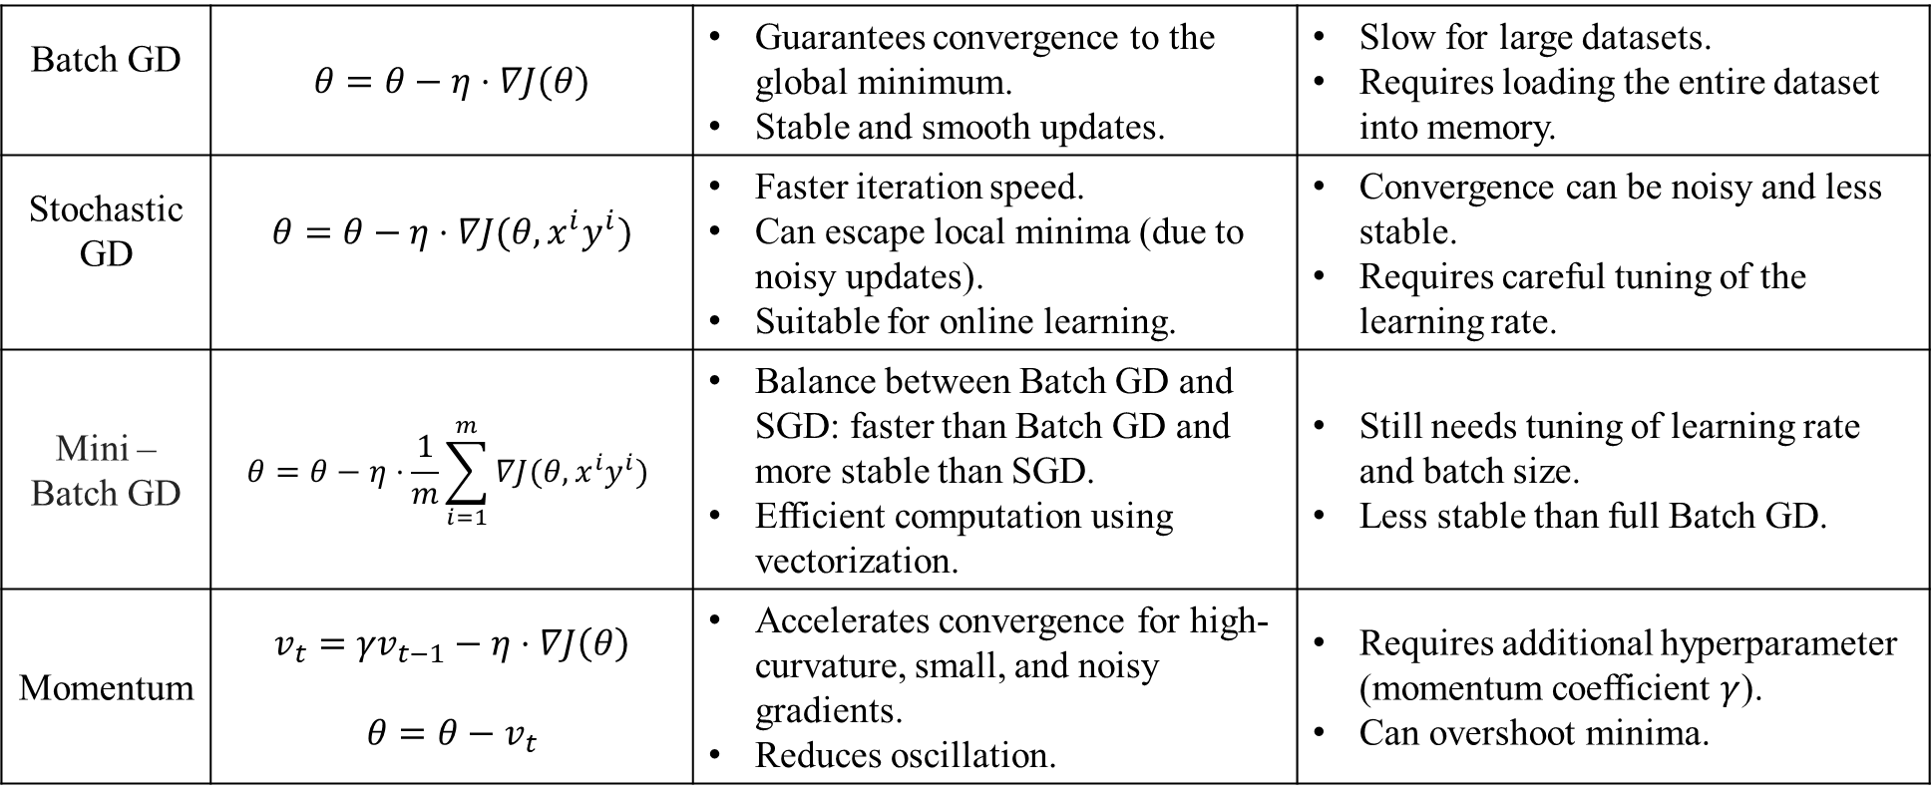
Gradient Descent Variants
Batch GD | $$θ=θ−η⋅∇J(θ)$$ | Guarantees convergence to the global minimum. Stable and smooth updates. | Slow for large datasets. Requires loading the entire dataset into memory.
Stochastic GD | $$θ=θ−η⋅∇J(θ, x^{i}y^{i})$$ | Faster iteration speed. Can escape local minima (due to noisy updates). Suitable for online learning. | Convergence can be noisy and less stable. Requires careful tuning of the learning rate.
Mini – Batch GD | $$θ=θ−η⋅\frac{1}{m}\sum_{i=1}^{m}{∇J(θ, x^{i}y^{i}) }$$ | Balance between Batch GD and SGD: faster than Batch GD and more stable than SGD. Efficient computation using vectorization. | Still needs tuning of learning rate and batch size. Less stable than full Batch GD.
Momentum | $$v_{t}={γv}_{t−1}−η⋅∇J\left(θ\right)$$ $$θ=θ−v_{t}$$ | Accelerates convergence for high-curvature, small, and noisy gradients. Reduces oscillation. | Requires additional hyperparameter (momentum coefficient $γ$). Can overshoot minima.
Notes:
Batch GD
Updates all parameters by computing the gradient over the entire dataset in one go. It can be slow for large datasets but guarantees convergence for convex problems.
Stochastic GD
Unlike Batch Gradient Descent, SGD updates parameters for each training example one at a time, making it faster and more suitable for large datasets, but with noisier convergence.
Mini – Batch GD
Combines the benefits of Batch and SGD by updating parameters based on a small random subset of the data (mini-batch), leading to faster and more stable convergence.
Momentum
$v_{t}$Velocity, which accumulates the gradient's past values. (Initial Value is generally zero)
$γ$ Momentum coefficient (typically between 0.5 and 0.9).
Adds a fraction of the previous update to the current update, helping to accelerate convergence and reduce oscillations, especially in ravines.

